Slide 1
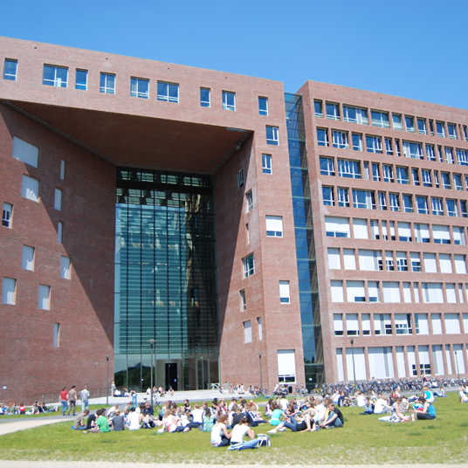



Acoustic profiler study

Slide 2
Aim of the project
Test the use of AZFP for monitoring marine life in OWFs
Monitor change in biomass over the course of 1 month, accross 3 different OWFs
Indication on the effect of seismics and pile driving sounds on marine communities

Slide 3
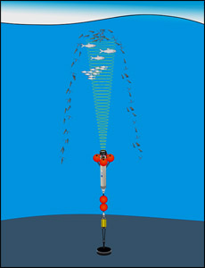
Principles
Upward looking devices
Long time monitoring
Multi-frequency ability
Initially designed for zooplankton monitoring

Slide 4
Frames
transducers

Slide 5
Recording plan
3 deployments
Belwind (seismic survey) – 15/07 to 11/08
C-Power (pile driving) – 22/08 to 20/09
Gemini (blank) - ? to ?
Pair deployment (in and out the OWF)
2 AZFP units
38, 125, 200, 455 kHz – deployed in the OWF
125, 200, 455, 769 kHz – deployed outside the OWF
Locations?

Slide 6
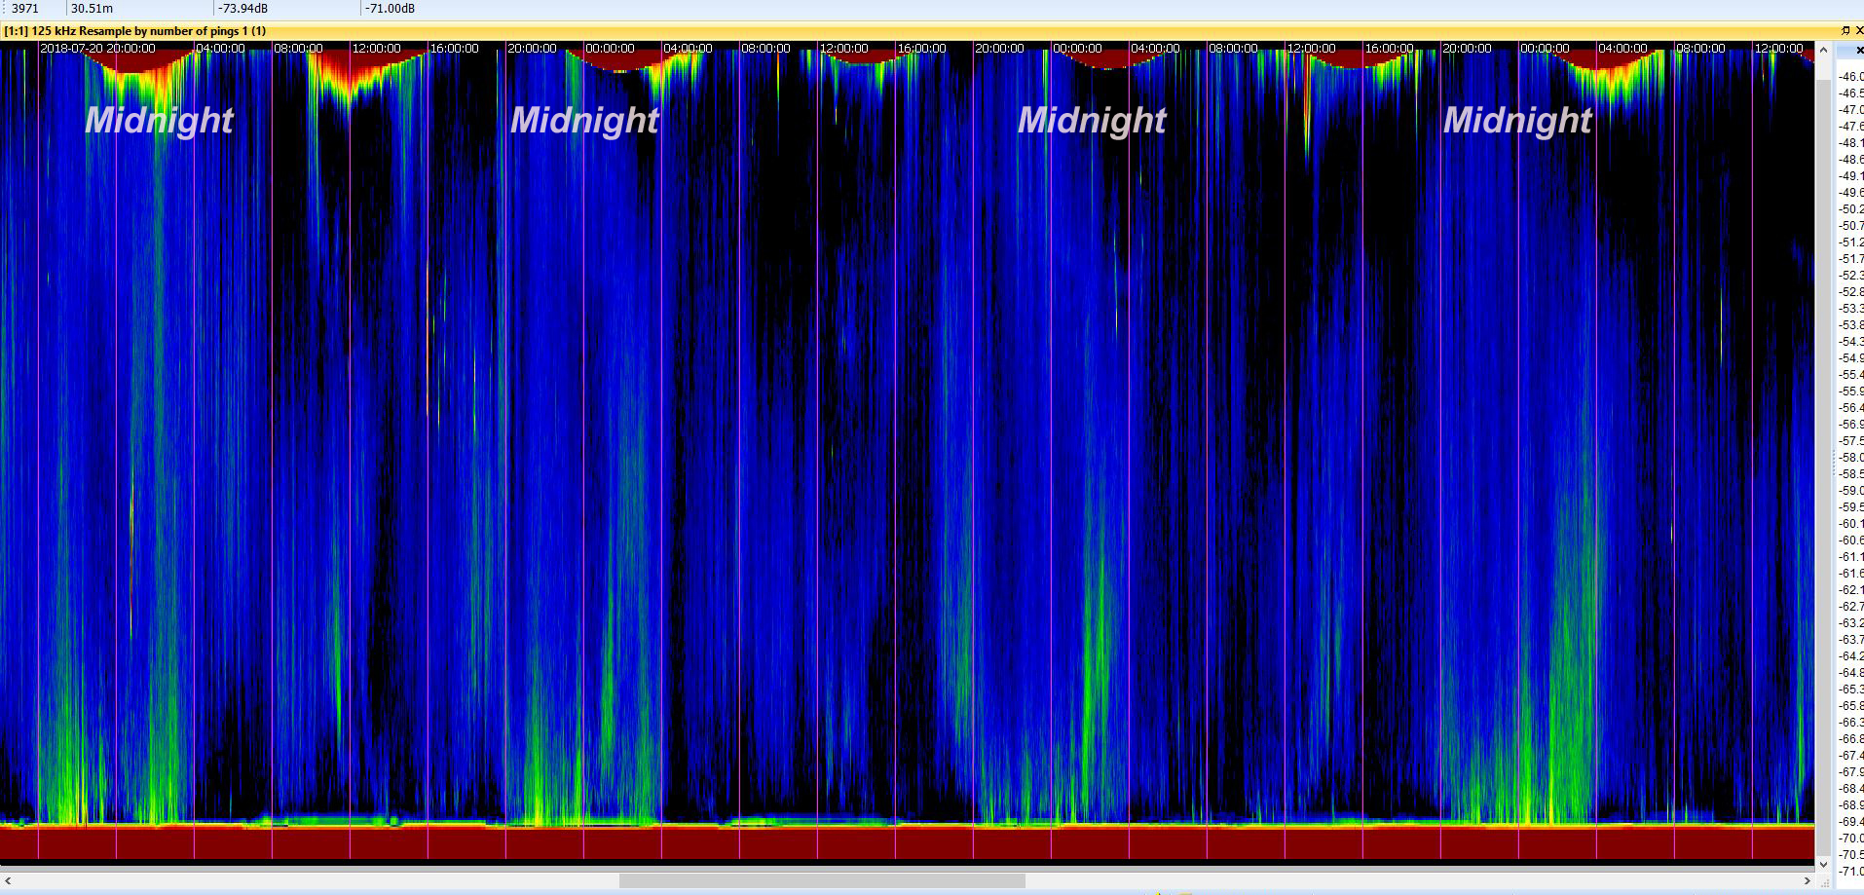
Data example

Slide 7
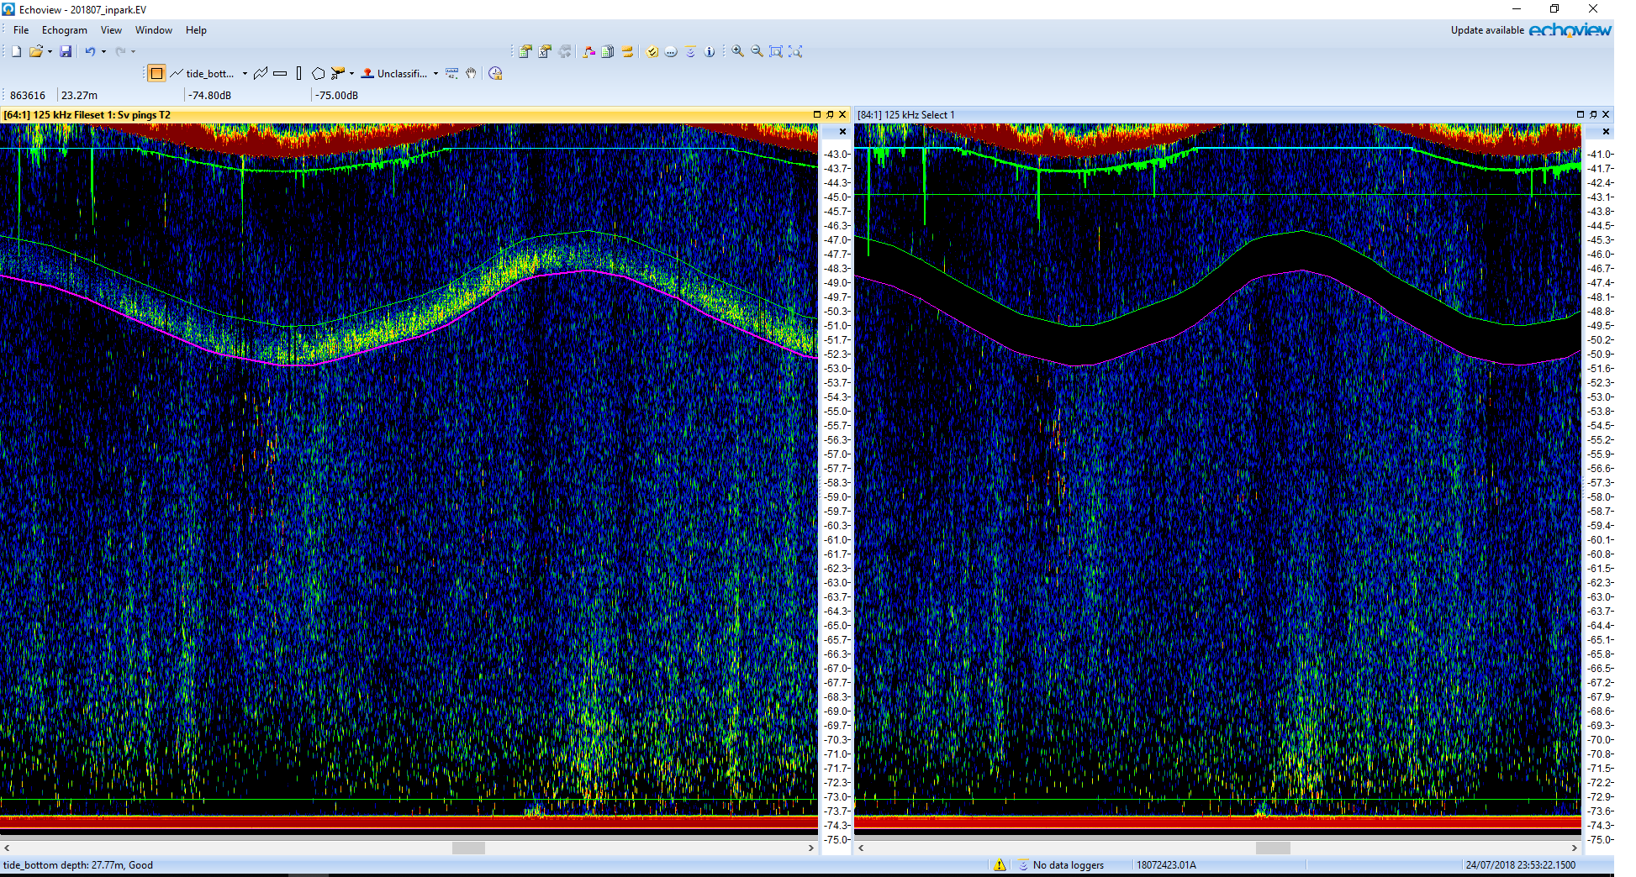
An annoying issue with the data...

Slide 8
Data processing
Data
Sv
Removal of bottom and surface bubbles
Integration @ 125 kHz with different methods

Slide 9
Processing outputs
Raw integration
Integration over thresholded data
63 dB
70 dB
Erosion/dilation steps based on thresholded data:
63 dB
70 dB

Slide 10
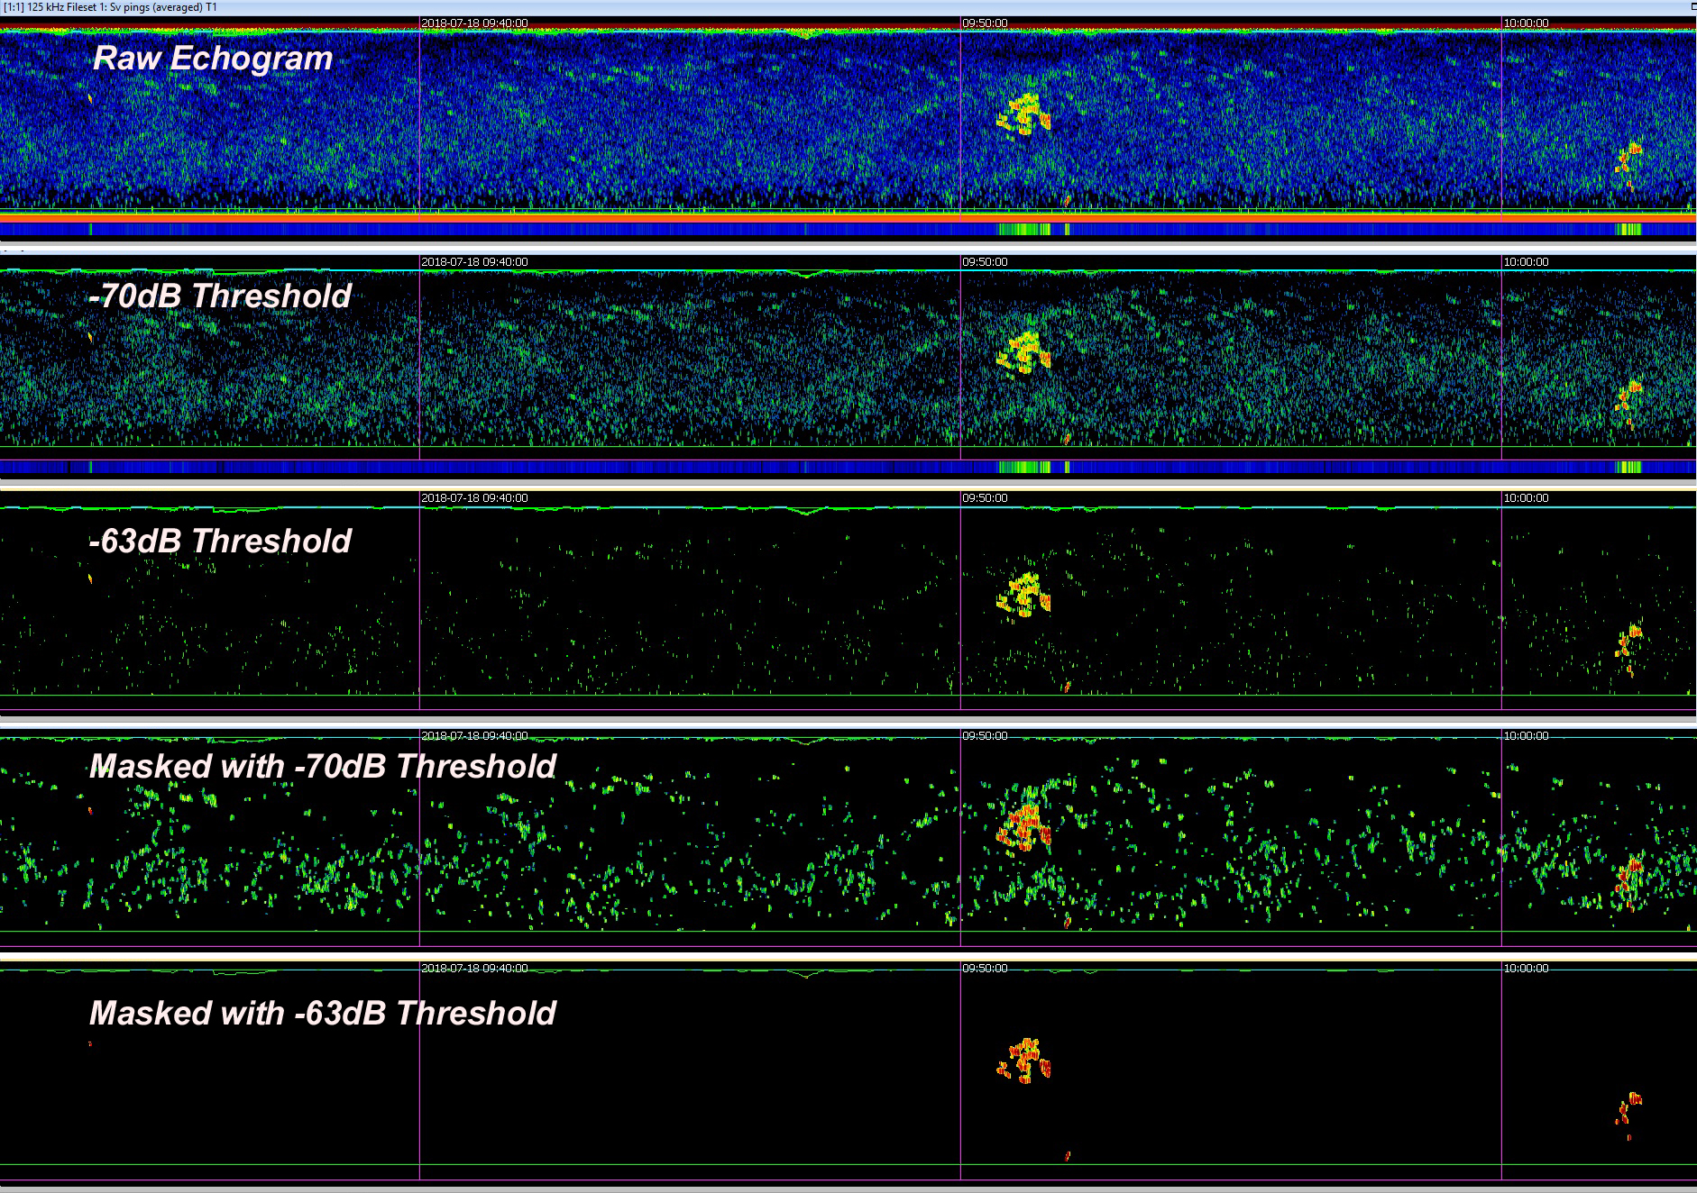
Processing

Slide 11
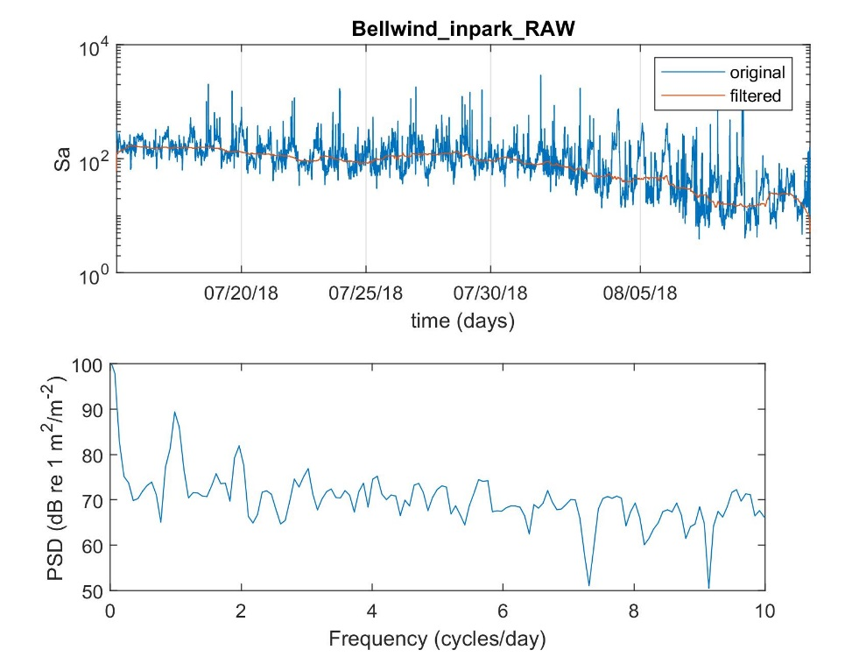
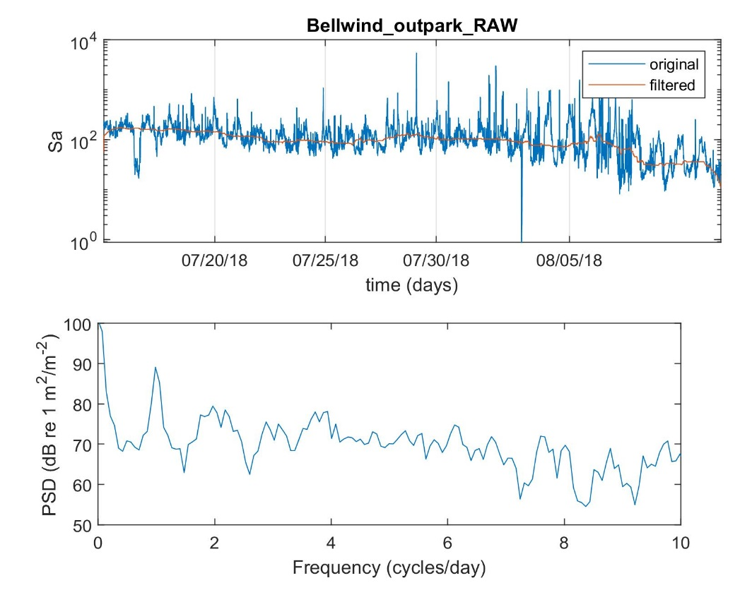
Results Belwind

Slide 12
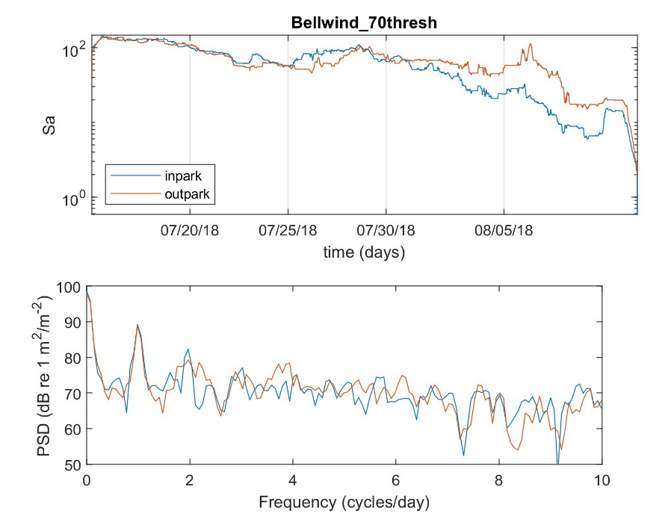
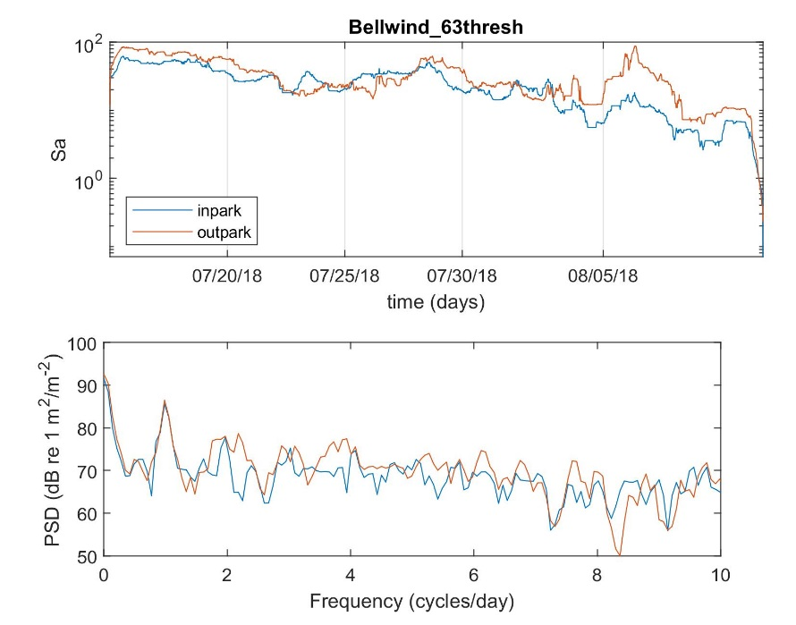
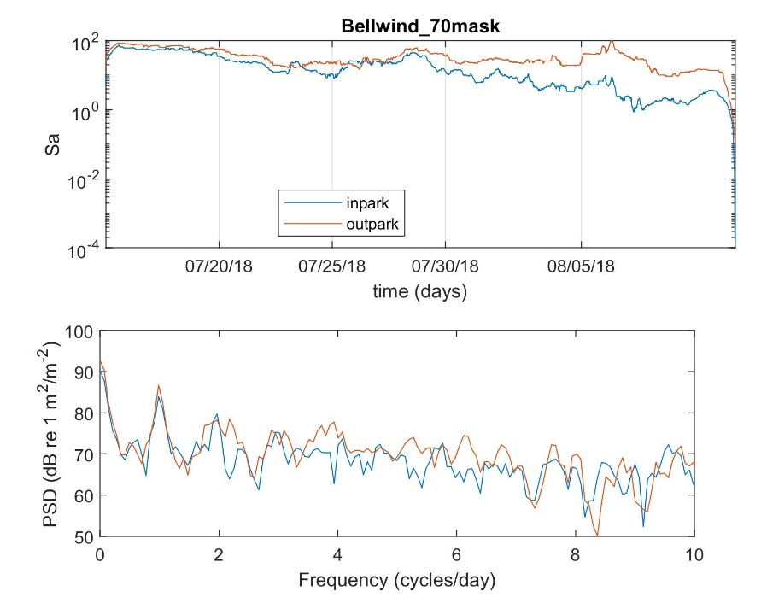
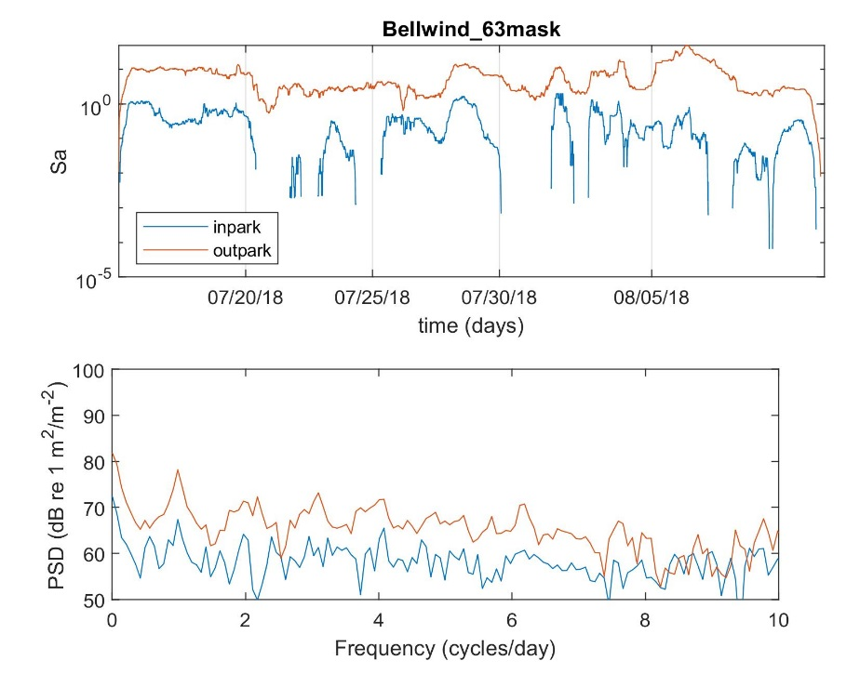
Results Belwind
Reduced “strong marks” in-park
Diurnal pattern

Slide 13
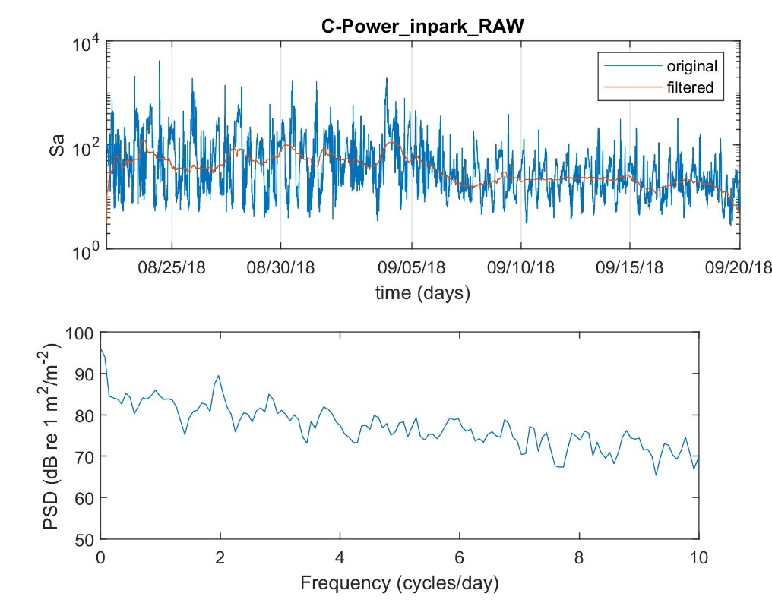
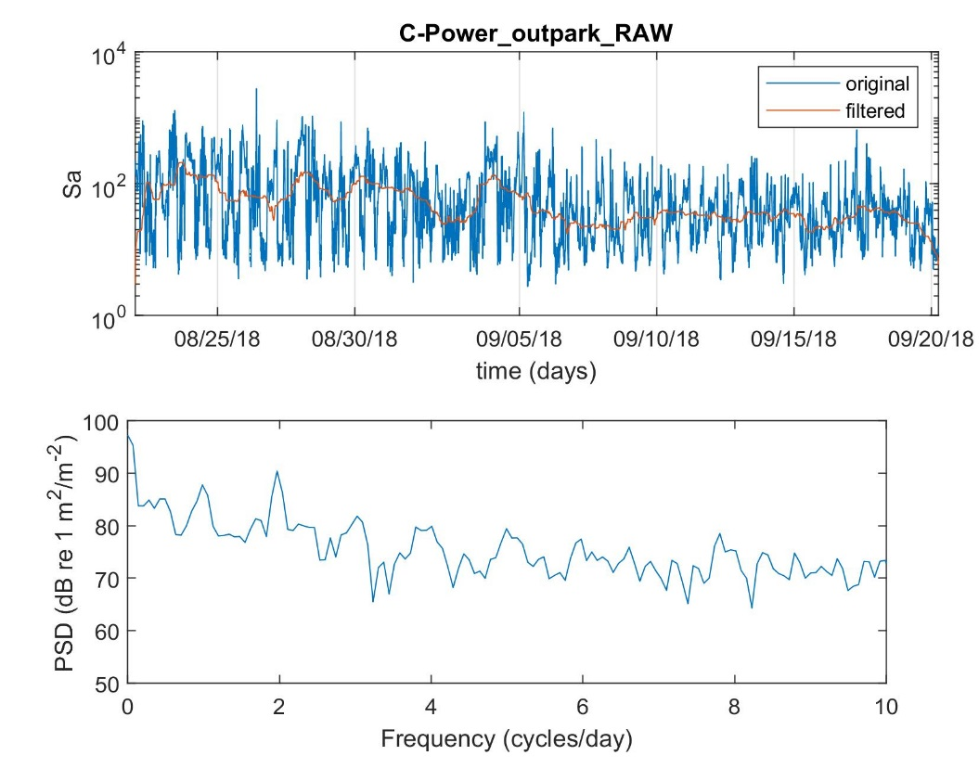
Results C-Power

Slide 14
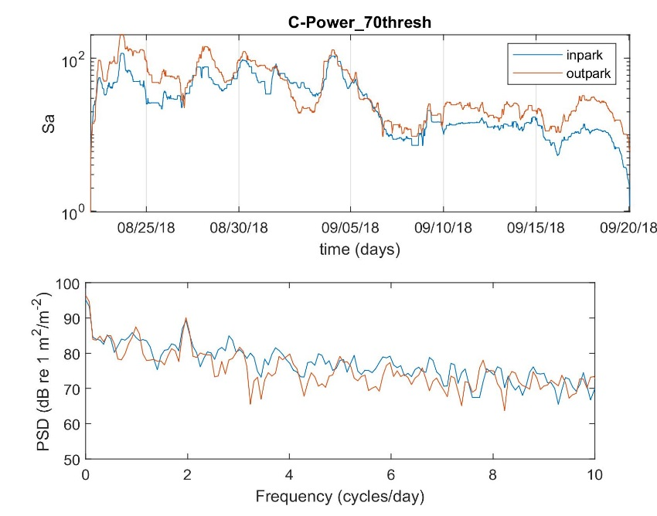
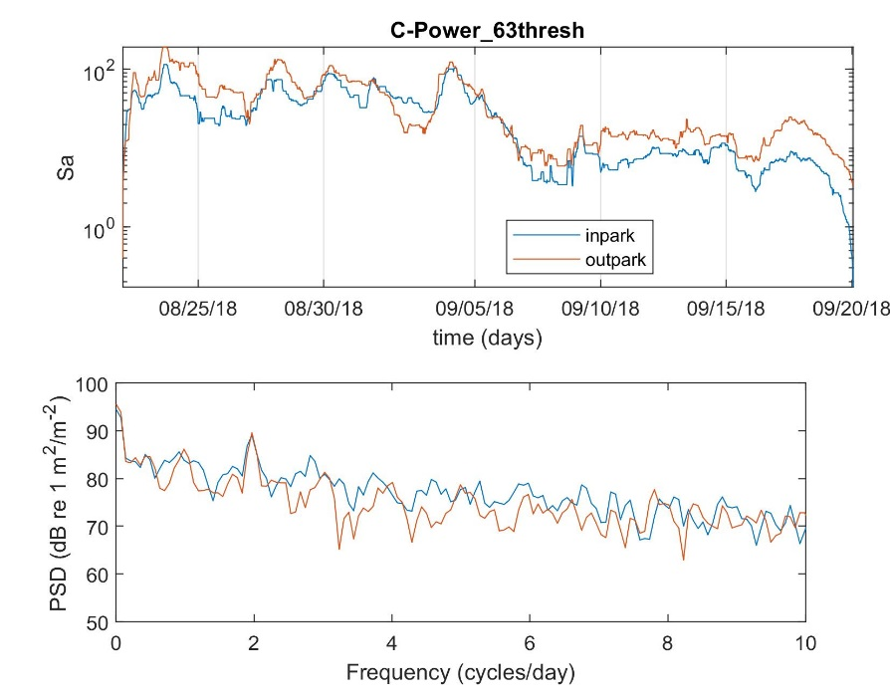
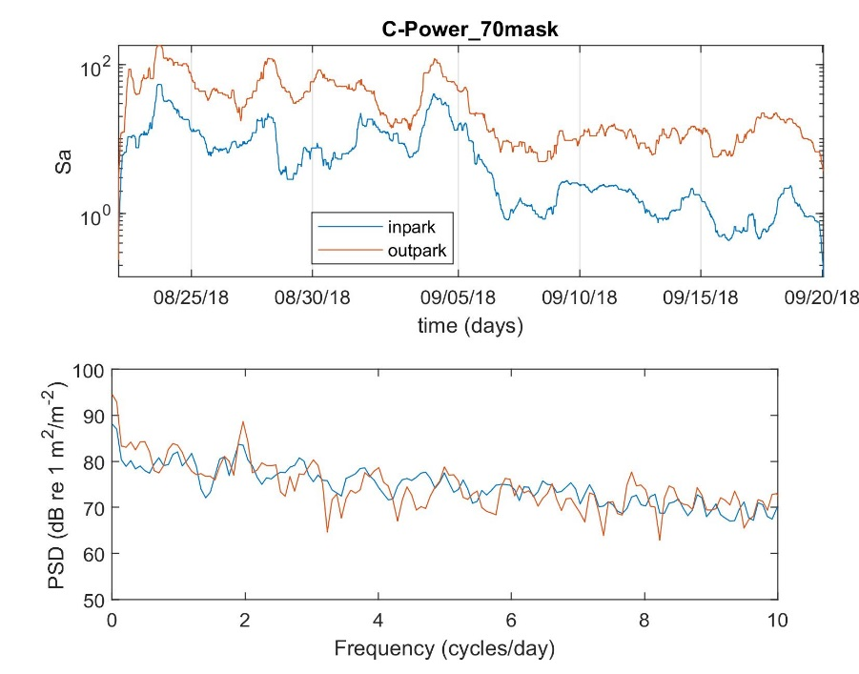
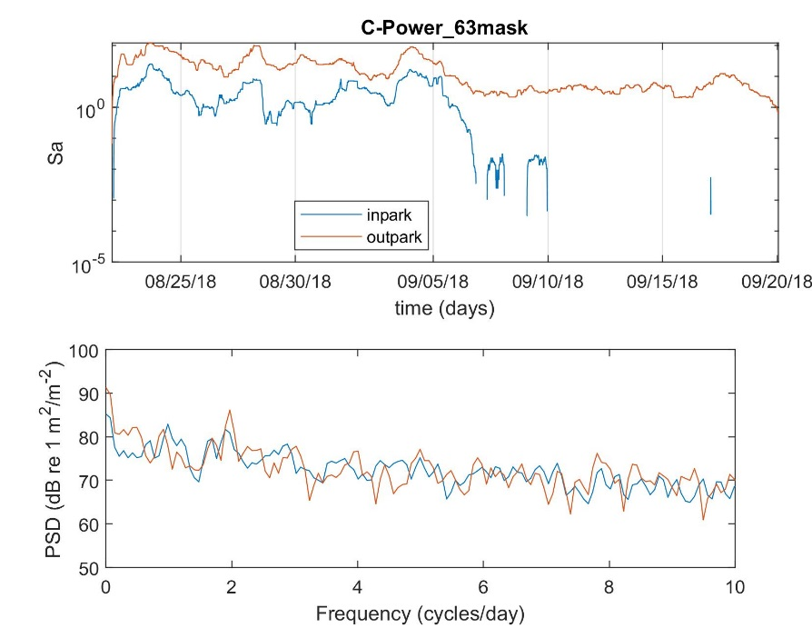
Results C-Power
Reduced “strong marks” in-park
Notes:
No diurnal pattern (semi-diurnal?). Bigger differences between the methods (especially thresholded and masked).

Slide 15
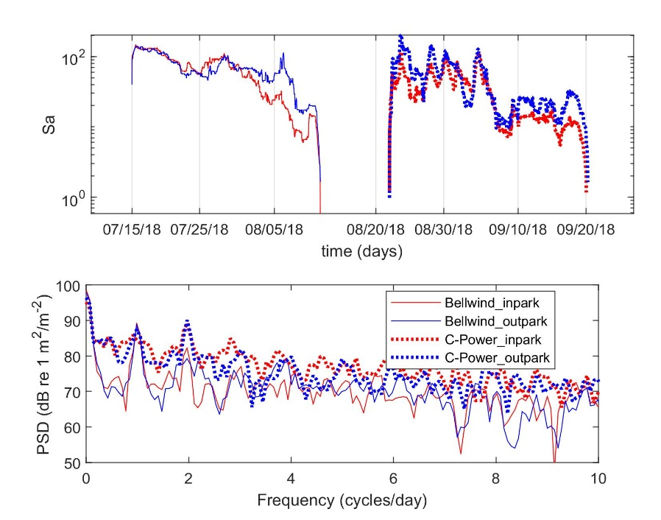
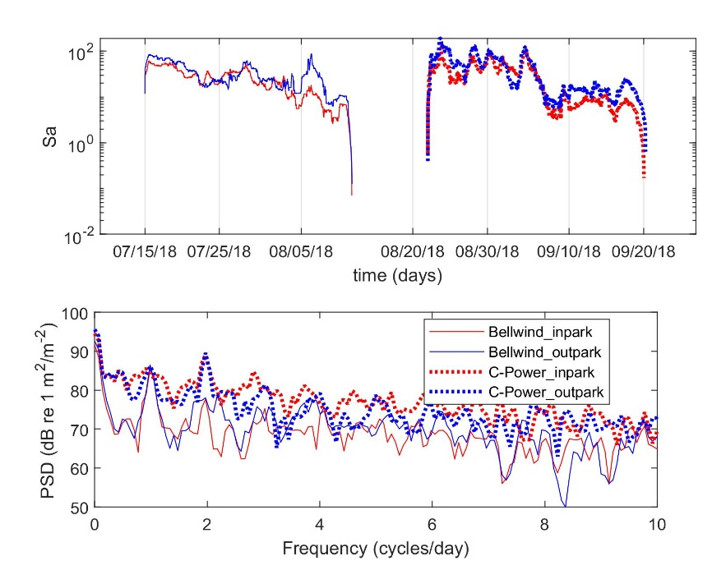
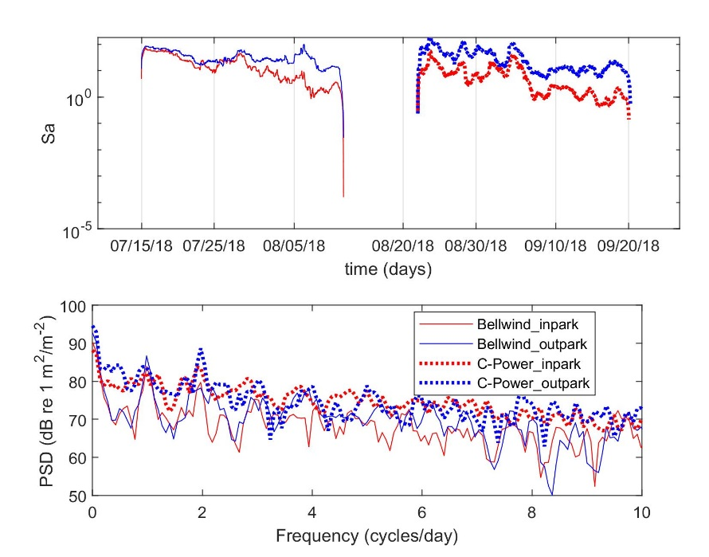
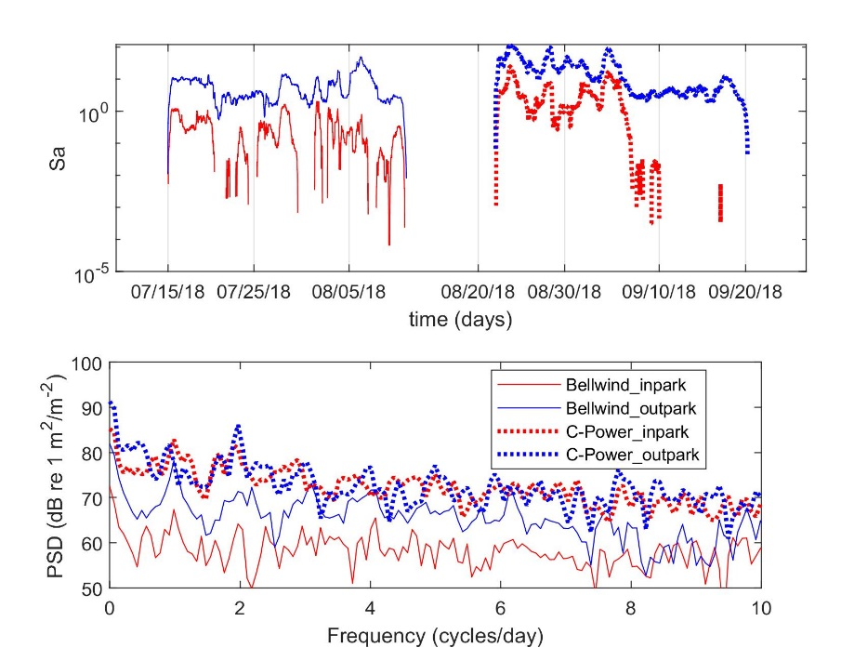
Results C-power/Belwind
Notes:
Drops around the edges are artefact from the median filter. Did not have time to fix it. Belwind has a bigger Sa overall. For both cases, we see a decreasing trend, maybe less pronounced for strong marks.

Slide 16
Further work?
Calibration
Check multi-frequency consistency between out and in park
Correlation results with tidal patterns and SEL

Slide 17
Project structure
Funded by RWS
Led by Leiden (Hans)
Deployment by VLIZ and WMR (aka Dick)
Processing of acoustic data by WMR
Further analysis by Leiden (Annebelle)?
Joint effort for reporting
Combined deployments with PCAD4cod

Slide 18
Some questions
Lack of ressources for last deployment?
How do we handle the last deployement? Can we skip the NL deployment?
What are the expectations from the results/report?

